Slide 1
Introduction to Objective-C and Xcode (Part 1)
FA 172.11
Special Topics in Design Production (Intro to Mobile App Development)

Slide 2
Technical sessions
Crash course in Objective-C
Tutorial on the Xcode development environment

Slide 3
What we have done so far
Created simple Xcode projects
HelloWorld App: Single-View application with a label, a text field, and a button
RiddleApp: Used a navigation controller, multiple views, and segues

Slide 4
Objectives of the technical sessions
Understand the rules of the Objective-C programming language
For beginners, learn programming
For programmers, learn a new language
Learn the Xcode development environment and its various features

Slide 5
Objective-C, Xcode, and iOS
Objective-C: programming language
Xcode: development environment
iOS: operating system for (Apple) mobile devices
Apps that run on devices under the iOS platform are developed in Objective-C using Xcode

Slide 6
Xcode projects
An Xcode project is a collection of settings, programs and resources
Settings indicate values for various parameters that direct how the project is built
Programs are files written using Objective-C code
Resources are other files such as images and data files that are required to build the project and execute the corresponding application
All the files of an Xcode project are contained in a specific folder

Slide 7
HelloWorld App revisited
Created using the Single-View template
A template provides pre-created files/programs to simplify development
Settings
e.g., project name (HelloWorld), target device (IPhone), deployment target (iOS 6.0), …
Interface was built and additional code was supplied to produce the intended app
Label, button, and text field were added through the interface builder (Xcode feature)
Code added caused text to be copied from the text field to the label through a button click

Slide 8
Programs and programming
What is a program?
Sequence of instructions that processes data on a computer
What is a programming language?
Rules for writing a program
Most basic components
Data: variables and types
Instructions: statements

Slide 9
Variables
Variables hold data/values
Variables are named
Variables are of a particular type
Examples of types: int (number), NSString (string)
Types restrict the values that a variable can hold
Objective-C variable declaration example:
int counter;
defines a variable called counter that holds an integer value

Slide 10
Some common types
Whole number – int
Sample values: 123, -8, 0
Floating point number – double
Sample values: 2.75, -9876.54321, 1.23e4
Switch/toggle – BOOL
Values: YES, NO
String of characters – NSString
Sample values: @"Hello", @"123", @":-)"

Slide 11
Working with variables
Declaration
double unitPrice, total; int itemCount; NSString *message;
Assignment
unitPrice = 125.75; itemCount = 5; total = itemCount*unitPrice; message = @"Hello, world.";

Slide 12
Working with variables
Output (using NSLog function)
NSLog(@"number of items: %d", itemCount); NSLog(@"%@", message); NSLog(@"%d x %f = %8.2f", itemCount,unitPrice, total);
Output (through an outlet connection)
self.label.text = message;

Slide 13
Testing some code
Create an Xcode project (Single-View template), add a button to the view on the storyboard, and then create an action outlet for the button named “go:”
In the .m source file, supply the following code within the go: method (between the { })
int itemCount; double unitPrice, total; NSString *message = @"Test code"; itemCount = 5; unitPrice =125.75; total = itemCount*unitPrice; NSLog(@"%@", message); NSLog(@"number of items: %d", itemCount); NSLog(@"%@", message); NSLog(@"%d x %f = %8.2f", itemCount, unitPrice, total);

Slide 14
Code
int itemCount;
double unitPrice, total;
NSString *message = @"Test code”;
itemCount = 5;
unitPrice =125.75;
total = itemCount*unitPrice;
NSLog(@"%@", message);
NSLog(@"number of items: %d", itemCount);
NSLog(@"%@", message);
NSLog(@"%d x %f = %8.2f", itemCount, unitPrice, total);

Slide 15
Summarizing what we have done
We wrote a sequence of instructions (or statements) and executed them through Xcode and the simulator
The statements involved variables
Declarations: established names and types for the variables
Assignment statements: assigned values to the variables
Function calls: displayed the values of the variables
Note: these statements follow Objective-C rules/syntax and conventions

Slide 16
Syntax of statements
Variable declaration:
<type> <name>;
<type> *<name>;
Assignment:
<name> = <literal-value>;
<name> = <expression>;
NSLog function call:
NSLog( <format-string>, <expression>, … );
Note that all of the above statements end with a semicolon

Slide 17
Accepted conventions
A name used in an Objective-C program is a sequence of letters and digits, but should start with a letter
Examples: Product, price, section123, totalAmt
Note that names (also called identifiers) are case sensitive
Convention for variable names in Objective-C:
Start with a lower-case letter
If the name comprises multiple words, capitalize the first letters of succeeding words
Examples: unitPrice, totalAmountInPesos

Slide 18
Expressions and operators
Assignment statements may involve complex operations, for example:
totalTax = 125000 + (income-500000)*0.32;
An expression is a combination of values, variables, operators, and computations through methods and functions
Operators: + - * / ( ) and many others
expression

Slide 19
NSLog
NSLog causes output to be displayed in the debug window of Xcode
Very useful during development
NSLog( <format-string>, <expression>, … );
The first argument of the function is a format string specifying what and how a value is displayed
% in the string specifies placeholders in the output
%d for integers, %f for doubles, %@ for strings
Succeeding arguments indicate the values to be displayed

Slide 20
NSLog examples
NSLog(@"number of items: %d", itemCount); number of items: 5
NSLog(@”%@ has %d hands ", name, numHands); Andrei has 2 hands
NSLog(@"%d x %f = %8.2f", itemCount, unitPrice, total); 7 x 125.750000 = 628.75

Slide 21
Converting between types
int num; double val; NSString *s;
Between int and double, done via straightforward assignment, but there is truncation when going from double to int
val = num; // ok, no problem: 123 becomes 123.0
num = val; // truncation occurs: 5.67 becomes 5
How about converting between numbers and strings?
Use conversion methods

Slide 22
Between strings and numbers
string to int
num = [s intValue];
string to double
val= [s doubleValue];
int to string
s = [NSString stringWithFormat:"%d",num];
double to string
s = [NSString stringWithFormat:"%f",val];
Similar to NSLog

Slide 23
Tip of the iceberg
Apps can contain a lot more code than what we have discussed so far
Concepts that will be discussed in the next sessions
Classes
Properties and methods
Header and implementation files
The statements we have learned (declaration, assignment, function call) enable us to write code to specify methods

Slide 24
Back to Xcode
Interface Builder
Managing connections between Objective-C code and the user interface

Slide 25
The Interface Builder in Xcode
The user interface is an essential component of an app
In many other platforms, separate “code” is required for an interface, sometimes written by the developer
In Xcode, this interface is created visually through the Interface Builder of Xcode using drag and drop commands
storyboard, views, controls

Slide 26
The Interface Builder in Xcode
The components of an interface are associated with the code you write through connections
Outlet connections enable retrieval of data to and from controls like labels or text fields
Action connections specify methods to be invoked when an event occurs such as a button click
Outlets and actions appear as Objective-C code in the .h and .m files
But the associations are carried out separately within Xcode (control-drag actions between interface and code)

Slide 27
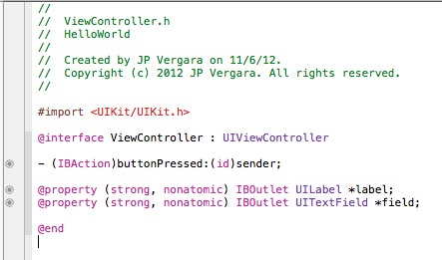
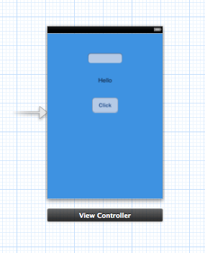
IB and connections
ViewController.h:
storyboard, controller, view, controls
In ViewController.m …

Slide 28
Managing connections
Click on view controller icon at the bottom of the storyboard
Then click on connections inspector
Ensure connections are as intended
Remove stray connections (usually resulting from name changes and dragging errors)

Slide 29
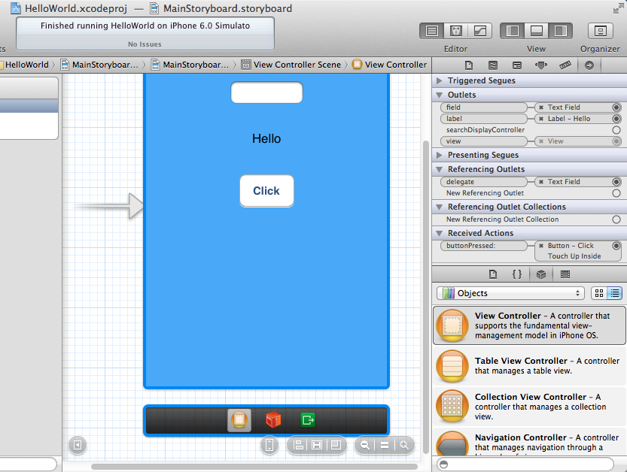

Slide 30
Exercise
Download and unzip the HelloWorld app you submitted early in the semester
Rename the property you associated with the label
Rebuild and execute the project and fix issues accordingly
Open connections inspector to manage connections

Slide 31
Summary
Objective-C basics: variables, computation, and simple statements
Xcode and Interface Builder: connections

Slide 32
Lab 2
Create a ComputePrice app
Single-view application
Controls
Two text fields, representing unit price and quantity (place labels beside the fields for clarity)
Display label
Compute button
Clicking on the button computes and displays total price

Slide 33
