Slide 1
Introduction to Objective-C and Xcode (Part 4)
FA 175
Intro to Mobile App Development

Slide 2
Agenda
Complete the ProductInventoryApp project
Class methods
Arrays

Slide 3
ProductInventoryApp
Instructions are posted on the course website
Summary
Two view controllers (controlled by a navigation controller), one for the main interface, the other for the product
Product class included in the project
Three products created by main view controller
Detail/product view controller has its display based on a product object

Slide 4
ProductInventoryApp: main view
No properties defined in ViewController.h file
No outlet connections
No action connections (button click functionality handled through the segues)
Three product variables declared outside of the methods within the ViewController.m file (these could have been properties but there is no reason to have the data available as properties)
Product objects created within viewDidload method (initialization code executed when view appears)
prepareForSegue method checks which button was pressed (which segue was used) and then sets the appropriate product to be set by the second view

Slide 5
ProductInventoryApp: product view
Separate class (with superclass UIViewController) had to be created and associated to this view controller
Properties defined in .h file
outlet connections for all controls (except buttons)
One product object (to be set by the main view, but used by this view for display)
Action connections (for the add and remove buttons)
viewDidload contains code (in .m file) that displays details of product object property
Code for the add/remove actions
Retrieve data from the text field and convert to int
Call increase/decrease method on the product object
Redisplay stock level

Slide 6
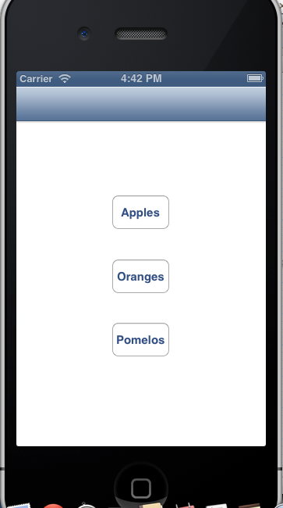
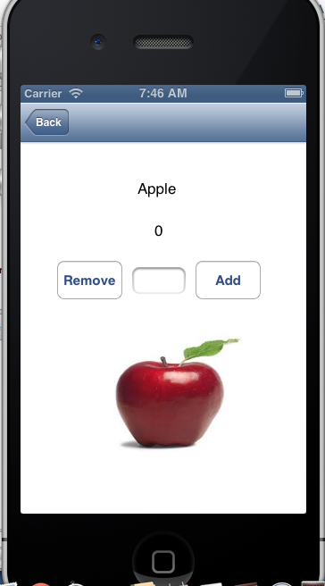
ProductInventoryApp

Slide 7
Class methods
In some situations, a method related to a class need not be called on a specific object, such as when:
The method applies to all objects of a class
The class is viewed as a container or manager of its objects and the method is at the level of the manager
Example: alloc is a “built-in” method of any class
[<class-name> alloc] returns a newly created/allocated instance/object under that class

Slide 8
NSString
The method integerValue is an instance method of NSString that returns an int
NSString *s = @"123";
int val = [s integerValue];
The method stringWithFormat is a class method of NSString that returns an NSString*
NSString *x;
x = [NSString stringWithFormat:"%d", val];

Slide 9
UIImage
imageNamed is a class method of UIImage that returns a UIImage object given an image file name
self.imageView.image =
[UIImage imageNamed:@"x.jpg"];
In contrast, size is an instance method (actually, a property) that returns the size of a given image
[self.imageView.image size]

Slide 10
Declaring and using class methods
Use a + instead of a - when declaring and defining a class method:
+(void) setInterestRate:(double)rate;
You may not use properties in these methods
Properties represent instance-level data
Example: an interestRate variable for a BankAccount class can be set by a class-level setInterestRate method
Declare interestRate in the .m file, outside of the methods

Slide 11
@interface BankAccount()
@property (readwrite) double balance;
@end
@implementation BankAccount
-(void) deposit:(double)amt
{
self.balance += amt;
}
double interestRate = 0.05;
-(void) applyInterest
{
double amt = self.balance*interestRate;
self.balance += amt;
}
+(void) setInterestRate:(double) rate
{
interestRate = rate;
}
@end
Declared outside
the methods

Slide 12
Arrays
Array: collection of variables of the same type
Suppose you had three variables (type double) that represent the yearly incomes of three different employees:
double income1;
double income2;
double income3;
Use an array instead to declare them “in batch”
double income[3];

Slide 13
Using arrays
Assignment using the non-array version:
income1 = 150000.00;
income2 = 2103456.78;
income3 = 555555.55;
Assignment using the array version
income[0] = 150000.00;
income[1] = 2120456.78;
income[2] = 555555.55;
Syntax: <array-name>[<integer-index>]
If n is the size of the array, indices go from 0..n-1

Slide 14
Looping through array elements
You may use loops to apply a statement for every array element
Non-array version
income1 = income1 + income1*0.10;
income2 = income2 + income2*0.10;
income3 = income3 + income3*0.10;
Array version using a loop
for(int i = 0; i <3; i++)
income[i] = income[i] + income[i]*0.10;

Slide 15
Array of objects
To store an array of five strings:
NSString *words[5];
words[0] = @"this";
words[1] = @"class";
words[2] = @"is";
words[3] = @"so";
words[4] = @"easy";
To print these strings:
for( int i = 0; i < 5; i++ )
NSLog(@"%@", words[i]);

Slide 16
Array classes
Arrays just discussed are “C-style” arrays
Alternative: create array objects using the Objective-C classes NSArray or NSMutableArray
NSArray (fixed-size)
Create and initialize using arrayWithObjects class method
NSMutableArray (dynamically-sized)
Create using [[NSMutableArray alloc] init]
Add new elements using addObject method

Slide 17
Array classes
To access individual elements
Use objectAtIndex method
Or use [ ]
Use the count property to determine the current size of the array
Refer to the test code in the course website for a demonstration of using NS array classes

Slide 18
Summary
Class method
Method that isnot called on an instance (it may return an instance)
Method that manages objects of the class
Methods that sets or gets data at the level of the class
Array
Collection of variables of the same type
Involves indexing and loops
C-style, NSArray, NSMutableArray

