Slide 1
Introduction to Objective-C and Xcode (Part 3)
FA 175
Intro to Mobile App Development

Slide 2
Recap of last two sessions
Intro to Objective-C and Xcode
Variables, types, computations, statements
Xcode: components, Interface Builder, connections
Object-oriented programming
Classes and objects
Properties and methods
Objective-C classes: .h and .m files

Slide 3
Agenda
More Objective-C details
Getters and setters
If statements
Product inventory app

Slide 4
Properties and method calls
Recall method call syntax
[<object-var-name> <method-name>]
[<object-var-name> <method-name>:<arg-val>]
Retrieving property values is equivalent to a method call
myCar.gasLeft is equivalent to [myCar gasLeft]
When you declare a property, a getter method is automatically created
-(double) gasLeft { return _gasLeft; }

Slide 5
Properties and method calls
Assigning a value to a property, e.g.
theProduct.stockLevel = 100;
Is equivalent to
[theProduct setStockLevel:100];
A setter method is also automatically created (for readwrite properties)
-(void) setStockLevel:(int) quantity { _stockLevel = quantity; }

Slide 6
Statements we know so far
Declarations
double salePrice;
Assignments
discount = salePrice*0.10;
Return statements
return computedValue;
Function calls
NSLog(@”Hello world”);
Method calls
[myCar driveDistance:94];

Slide 7
Conditional execution
Sometimes, we want a statement executed only when a condition is met
if-statement syntax:
if (<condition>) <statement>
if (<condition>) <statement> else <statement>

Slide 8
If-statement example
In a withdraw method of a BankAccount class… if (self.balance >= amount) self.balance = self.balance - amount;
Better yet,
if (self.balance >= amount) self.balance = self.balance - amount; else NSLog(@”insufficient balance”);

Slide 9
Blocks
If multiple statements need to be conditionally executed, group as a block and enclose with { } if (self.balance >= amount) { self.balance = self.balance - amount; NSLog(@”%f withdrawn”,amount); } else NSLog(@”insufficient balance”); NSLog(@”Thank you.”);
Note: The last statement is executed unconditionally

Slide 10
Conditions
Conditions are a result of calculations that use
Relational operators: > < == <= >=
Logical operators: && || !
Conditions return values of type BOOL
e.g., 10 > 5 returns a YES, 1 == 2 returns a NO
The NSString function has a method for comparing strings
-(BOOL) isEqualToString:(NSString *) otherString;

Slide 11
Product inventory app
Three projects
ProductInvAppPrototype
Focus on user interface
ProductTest
Focus on a product class
ProductInvApp
Create the final app

Slide 12
ProductInvAppPrototype
Create a single view project with three buttons
Embed in a navigation controller
Select the view controller, then Navigator -> Embed In -> Navigation Controller
Add one view controller to the storyboard with a label and an image view
Set label text to some product name (e.g., “Apple”)
Get an image file from the web representing the product (e.g., apple.jpeg), then drag onto “Supporting Files” section
Select the ImageView control, set the image file name

Slide 13
ProductInvAppPrototype
Make two more copies of the view controller (that contains a label and an image)
Update these two copies so the three views represent different products (e.g., apple, orange and pomelo)
Control-drag from each button to a view controller to create the corresponding segues
Select “push”
Build and execute

Slide 14
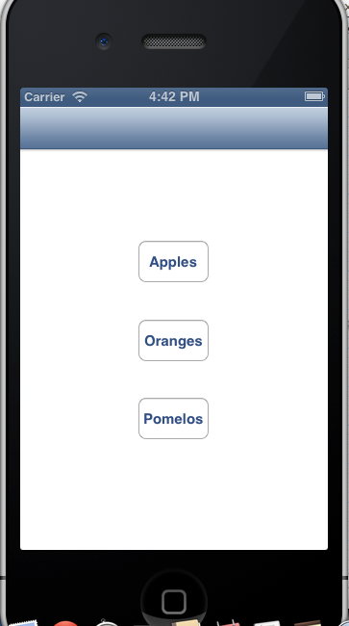
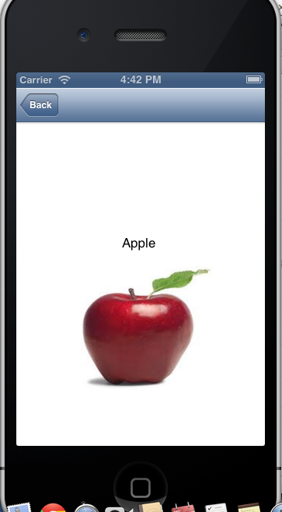
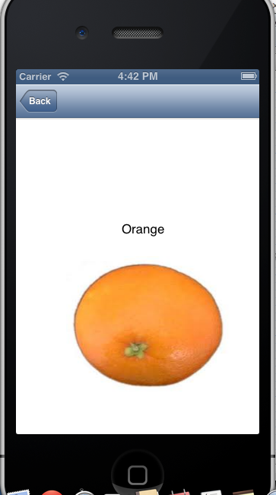
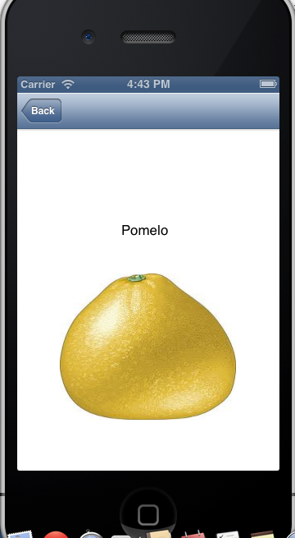

Slide 15
ProductTest
Create a single-view application with a single button
Add an action connection
Test code will be placed inside this method
Create a Product class
Add three properties: name, imgFileName, and stockLevel (the first two are of type NSString* the third is an int)
Add method: -(void) increaseInvenory:(int) qty
Add method: -(void) decreaseInventory:(int) qty
Test the Product class

Slide 16
ProductInventoryApp
Follow instructions to be posted on the course website
Summary
Two view controllers (controlled by a navigation controller), one for the main interface, the other for the product
Product class included in the project
Three products created by main view controller
Detail/product view controller has its display based on a product object

